Slide 1
FOUNDATION
Financial Application Development Platform

Slide 2
FOUNDATION – Introduction
Single Git repository
Java 17 with extensive use of functional interfaces
Fully integrated service oriented architecture
All components share same configuration, logging, scheduling and base service
Best of class open source technologies for each business function
DataDictionary based code generation tool for FIX to Protobuf translation
No more parsing FIX strings!
OpenTelemetry integration for distributed system introspection

Slide 3
FOUNDATION – Current Service List
Open Telemetry Service(s)
Prometheus, Jaeger Tracing, OTEL Collector
Configuration Service
GRPC service that provides configuration for all FOUNDATION based services
Scheduler Service
Java scheduler that leverages FOUNDATION based config to start / stop jobs
WebApp Service
Provides Bootstrap based ‘single-page’ webapp functionality
Market Data Service
Multicast market data consumer which publishes depth of book
Gateway
Example FIX 4.2, 4.4, 5.0 client and venue services driven entirely from codegen

Slide 4
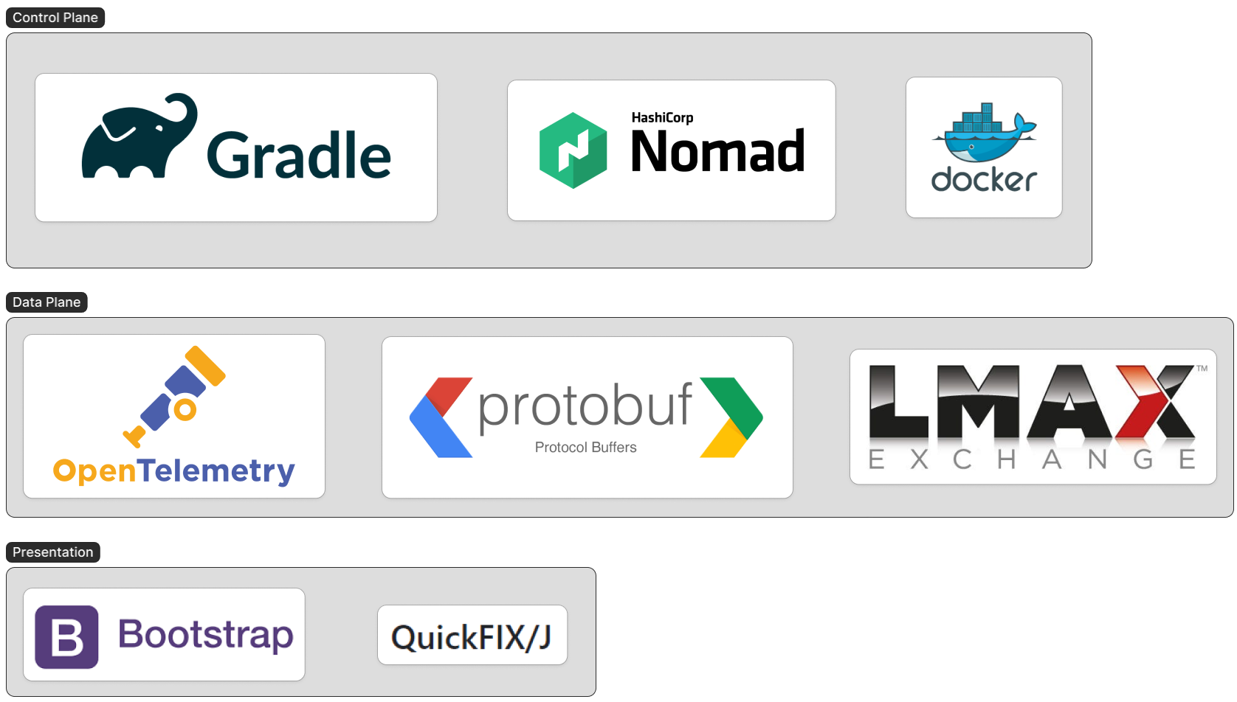
FOUNDATION – Core Components

Slide 5
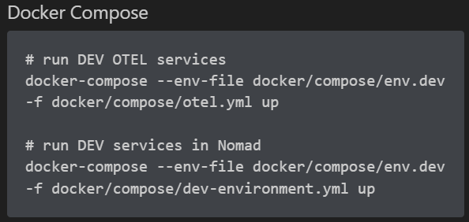
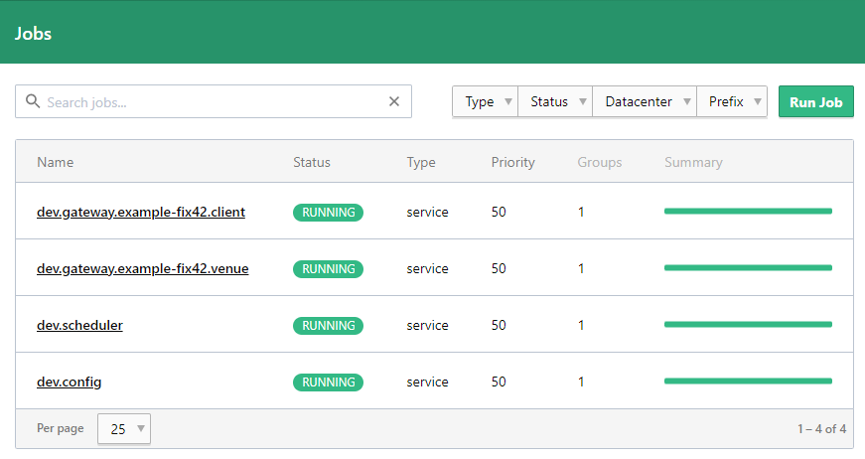
FOUNDATION – Control Plane
Execute two docker compose commands and you have a runtime environment with all the service management features Nomad provides.

Slide 6
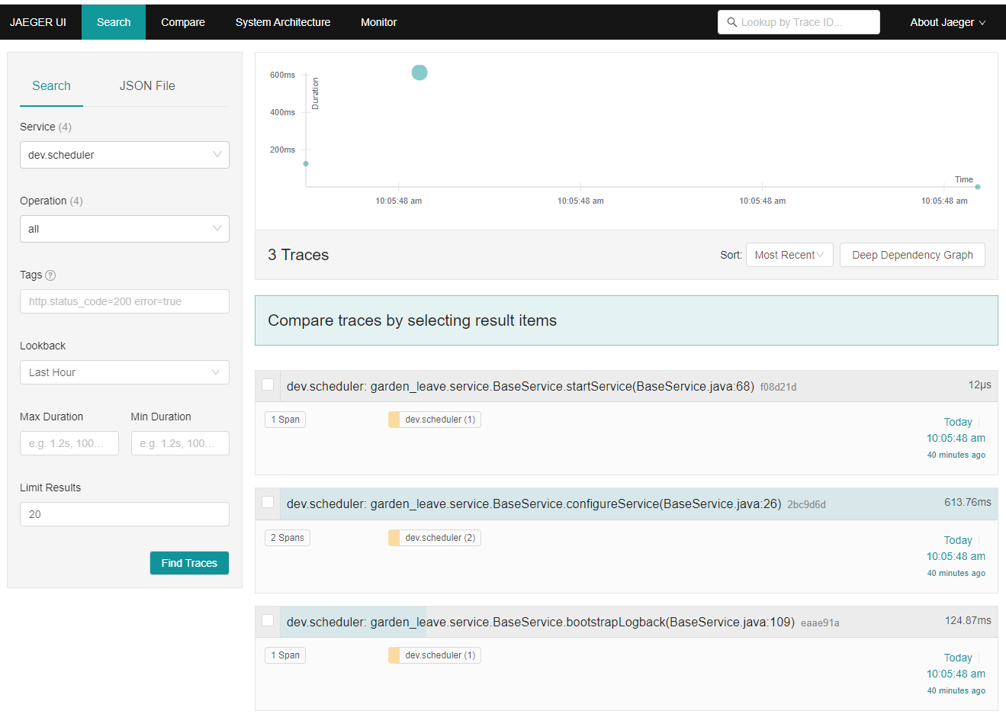
FOUNDATION – Data Plane
https://www.jaegertracing.io/
Capture all your application telemetry for system monitoring, performance analysis and troubleshooting.
OTEL [trace, meter] service hooks integrated into the base service architecture.

Slide 7
FOUNDATION – code generation (codegen)
Message specification driven development
Start with a data dictionary customized for the venue API (ie remove all the unused messages and fields)
Run the code generator, outputting bespoke protobuf, Java class files
Java class files contain:
Optimized QuickFIX MessageFactory
Individual Message objects able to transform [FIX → protobuf], and [protobuf → FIX]
MessageEvent for use with LMAX disruptor
ApplicationFunctionalAdapter (ie: quickfix MessageCracker but better)
MessageEventConsumer stub interface for consuming MessageEvent from LMAX
Support for all FIX versions (42, 44, 50, T11) and repeating groups

Slide 8
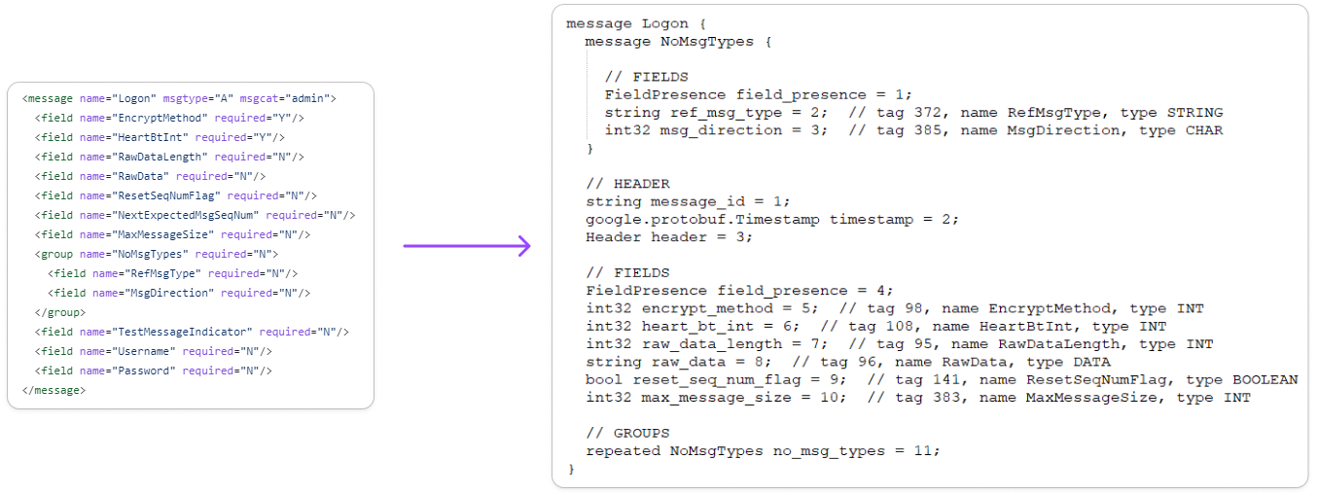
FOUNDATION – codegen – protobuf definition
Quickfix XML data dictionary
Protobuf message definition

Slide 9
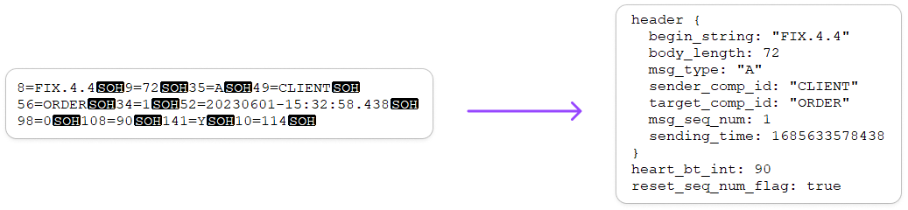
FOUNDATION – codegen – automagic FIX handling
FIX Logon message
logon.toString()

